Slide 1
Spot To Go
Android App — Development Progress Presentation
Academic Project | Kotlin + Jetpack Compose | Google APIs
June 2026
Notes:
Welcome everyone. This presentation covers the end-to-end development progress of Spot To Go — an Android application that helps users discover nearby restaurants on a live map, preview them via video, and get directions. Today we'll walk through the Google Cloud API setup, Android Studio configuration including the virtual device challenge we hit, the project's file structure, and a live demo of the three working screens.

Slide 2
Project Overview
What is Spot To Go and why was it built?
Core App Purpose
• Discover nearby restaurants on an interactive Google Map
• Tap any restaurant marker to see its name, cuisine, rating, and distance
• Watch a real video preview (YouTube) directly from the detail screen
• Launch turn-by-turn navigation to the restaurant via Google Maps
• Optional login — 'Continue as Guest' lets anyone explore immediately
Tech Stack
• Language: Kotlin
• UI Framework: Jetpack Compose
• Maps: Google Maps SDK for Android
• Location: FusedLocationProviderClient
• Restaurant Data: Seeded (Places API next step)
• IDE: Android Studio Quail 1
Notes:
Spot To Go is an academic Android project. The core idea is simple: open the app, see a live map centred on your GPS position, see restaurant markers nearby, tap one to read the details, watch a preview video, or get directions. We chose Kotlin because it is the modern default in Android Studio. Jetpack Compose replaced XML layouts — it is declarative and much faster to write. The login screen exists to demonstrate navigation flow; for this demo phase 'Continue as Guest' bypasses authentication so we can focus on the map and restaurant features.

Slide 3
Step 1 — Google Cloud Console: API Setup
Enabling Maps SDK and Places API for the Android app
Setup Steps
• Go to console.cloud.google.com → Create new project (e.g. 'SpotToGo')
• Enable APIs & Services → Search and enable: Maps SDK for Android
• Enable APIs & Services → Search and enable: Places API
• Go to Credentials → Create API Key → restrict to Android apps
• Copy the API key — it will be stored in local.properties (never committed to Git)
• In AndroidManifest.xml: add meta-data tag referencing ${MAPS_API_KEY}
• In app/build.gradle.kts: read local.properties and inject via manifestPlaceholders
Security note: local.properties is listed in .gitignore — the API key is never pushed to version control.
Notes:
The first real setup step before writing a single line of Android code was creating the project in Google Cloud Console and enabling two APIs. Maps SDK for Android renders the interactive map tile layer. Places API (Nearby Search) will return live restaurant data once we move beyond the current seeded data phase. The API key is injected at build time via manifestPlaceholders in Gradle, reading from local.properties. This file is gitignored so the key is never accidentally exposed in version control — an important security practice even for academic projects.

Slide 4
Step 2 — Android Studio Setup
Installing the IDE and scaffolding the project
Installation & Configuration Steps
• Installed Android Studio Quail 1 (latest stable release)
• Created new project: 'Empty Activity' template → Jetpack Compose
• Package name: com.example.spottogo Min SDK: API 24 (Android 7.0+)
• Added dependencies in libs.versions.toml (version catalogue):
• maps-compose 4.3.3, play-services-maps 18.2.0
• play-services-location 21.0.1, accompanist-permissions 0.34.0
• navigation-compose 2.7.7, material-icons-extended (via Compose BOM)
• Compose BOM 2026.02.01 manages all Compose library versions centrally
• Fixed Gradle sync bug: kotlin-android plugin was missing from libs.versions.toml
Notes:
Android Studio Quail 1 is the current stable release. We chose the Empty Activity template with Jetpack Compose because it gives a clean starting point without legacy XML boilerplate. The version catalogue in libs.versions.toml is a Gradle best practice: all library versions are declared in one place so they can be updated without hunting through multiple build files. One issue we hit early: the kotlin-android plugin was missing from the catalogue, which silently prevented the Kotlin compiler plugin from loading during Gradle sync. Adding it resolved the sync failure. We also hit a material-icons import error because material-icons-extended was not declared as a dependency — adding it fixed all icon resolution errors in the IDE.

Slide 5
Step 3 — Virtual Device (Emulator) Setup
Creating an Android Virtual Device and resolving the BIOS virtualisation issue
Creating the AVD
• Open Android Studio → Device Manager → Create Virtual Device
• Selected: Pixel 6 (Medium Phone) — API 35 system image downloaded
• First run attempt: emulator failed to start — Run button stayed greyed out
Problem Encountered
• CPU virtualisation (VT-x / AMD-V) was disabled in BIOS
• Confirmed via PowerShell: HyperVRequirementVirtualizationFirmwareEnabled = False
• Android Emulator requires hardware virtualisation to run
• Gradle sync error (kotlin plugin) also kept the Run button disabled
Fix Applied
• Entered BIOS settings on restart
• Enabled Intel VT-x (Intel Virtualisation Technology)
• Saved & restarted the machine
• Re-ran AEHD silent installer as Administrator
• Emulator launched successfully — app deployed and running
Notes:
This was the most significant setup blocker. The Android emulator uses hardware virtualisation (Intel VT-x or AMD-V) to run efficiently. On this machine, that feature was disabled at the BIOS level. We diagnosed it by running a PowerShell command that reported HyperVRequirementVirtualizationFirmwareEnabled as False — meaning the BIOS was the only remaining blocker; Hyper-V and Windows Hypervisor Platform were already disabled. The fix was to reboot into BIOS, find the Intel Virtualisation Technology setting, enable it, save and restart. After that we re-ran the Android Emulator Hypervisor Driver (AEHD) silent installer as Administrator to register the hypervisor. The emulator then launched and the app deployed successfully.

Slide 6
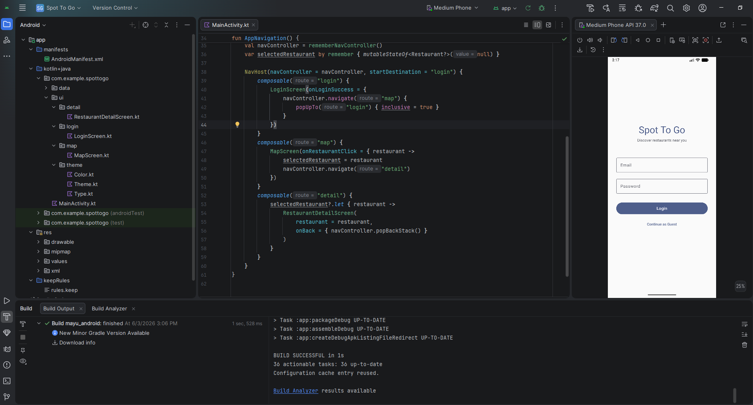
Project Structure
How the codebase is organised — one folder per screen
Key Files
• MainActivity.kt — NavHost wiring all screens
• data/Restaurant.kt — data class + 5 seeded restaurants
• ui/login/LoginScreen.kt — login & guest entry
• ui/map/MapScreen.kt — map, GPS, markers, search bar
• ui/detail/RestaurantDetailScreen.kt — info, video, directions
•
• AndroidManifest.xml — permissions + API key injection
• app/build.gradle.kts — dependencies & manifestPlaceholders
• gradle/libs.versions.toml — version catalogue
• local.properties — API keys (gitignored)
Notes:
The screenshot on the left shows the actual Android Studio file tree and editor. The project follows a simple feature-folder structure: each screen lives in its own sub-package under ui/. The data layer is a single file — Restaurant.kt holds both the data class and the repository with 5 hardcoded seed restaurants. MainActivity.kt is the entry point and navigation host; it uses Jetpack Navigation Compose to wire the three destinations: Login, Map, and Detail. The Gradle version catalogue (libs.versions.toml) keeps all dependency versions in one place, which is the modern recommended approach over hardcoding versions directly in build.gradle files.

Slide 7
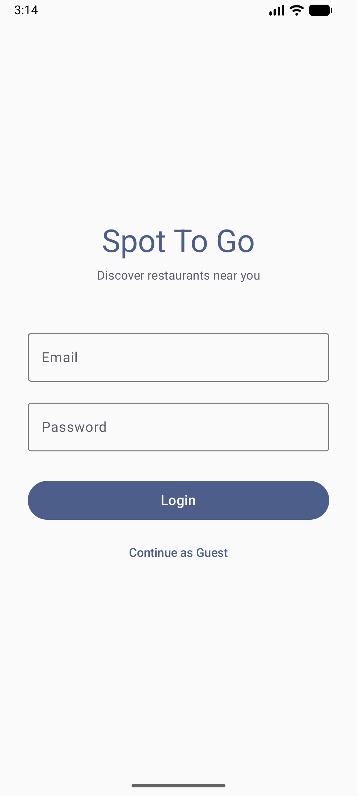
Screen 1 — Login
Entry point and navigation gateway to the main app
What This Screen Does
• Displays app name 'Spot To Go' and tagline
• Email + Password fields for future Firebase Auth integration
• 'Login' button — primary action (auth logic to be added in Phase 6)
• 'Continue as Guest' — bypasses login entirely for the demo
•
• Navigation flow:
• Login button → MapScreen
• Continue as Guest → MapScreen
•
• Design intent:
• Clean, minimal layout — no distracting elements
• Steel-blue colour palette consistent across all screens
• Guest option prioritised for academic demo purposes
Notes:
The login screen is deliberately minimal. Both the Login button and Continue as Guest navigate to the same MapScreen at this stage — the distinction is that Login will eventually validate credentials against Firebase Authentication in Phase 6 of the plan. The 'Continue as Guest' option was an intentional design decision: for the academic demo and presentation, we want to show the map and restaurant features quickly without needing a real account. The colour palette — a muted steel blue on a light grey background — was chosen to feel trustworthy and clean, matching the app's purpose of helping users make decisions about places to eat.

Slide 8
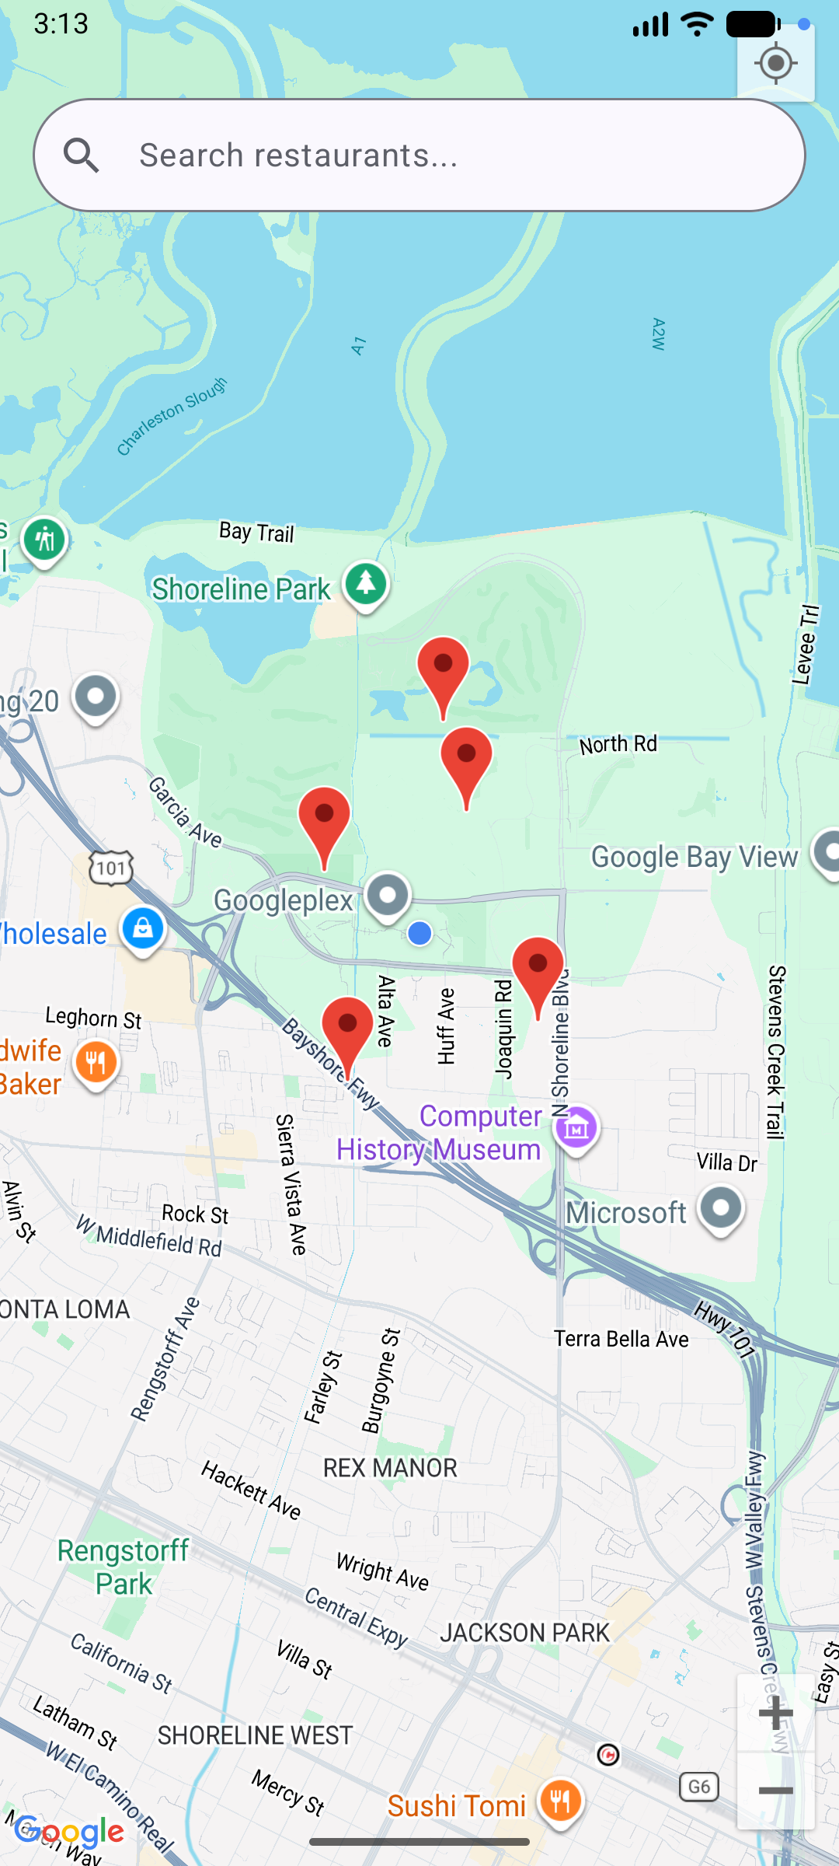
Screen 2 — Map & Search
Live Google Map centred on GPS location with restaurant markers and search
What This Screen Does
• Google Map loads and centres on the device's live GPS coordinates
• FusedLocationProviderClient provides battery-efficient location updates
• Location permission requested at runtime via Accompanist Permissions
• 5 restaurant markers placed at seeded coordinate offsets from user position
• Each marker stores a Restaurant object as its tag
•
• Search bar — Agentic AI powered (Key Innovation):
• Current: keyword filter — matches by name or cuisine type in real-time
• Planned: Gemini API integration for natural language understanding
• e.g. "Best cheap food near me" / "Quiet cafe for studying"
• AI extracts intent → cuisine, vibe, price range → ranks matched results
• Genuine agentic behaviour: AI understands goal, not just keywords
•
• Tap any marker → navigate to Restaurant Detail screen
• Back-stack managed automatically by Jetpack Navigation Compose
Notes:
This is the core screen of the app. The Google Map is rendered using maps-compose, the official Jetpack Compose wrapper for the Maps SDK. When the screen first loads it requests ACCESS_FINE_LOCATION permission — if granted, FusedLocationProviderClient returns the device's GPS position and the camera animates to that location. The 5 restaurant markers are currently seeded at fixed coordinate offsets from the user's GPS position.
The search bar is a key innovation in this design — it is built as an Agentic AI powered feature. In the current phase it operates as a real-time keyword filter: typing a name or cuisine type immediately recomposes the map and shows only matching markers. This is the foundation layer.
The planned next step is to integrate the Gemini API, which upgrades the search bar from a simple keyword filter to a genuine natural language interface. Instead of typing 'Italian', a user could type 'Best cheap food near me' or 'Quiet cafe for studying' — and the AI will parse the intent, extract attributes like cuisine type, price range, and vibe, then rank the Places API results accordingly. This is what makes it agentic: the system understands the user's goal and acts on it, rather than just matching exact words.
In the next phase we also replace the 5 seeded restaurants with a live Places API Nearby Search call returning real restaurants within 1500 metres of the user's location.

Slide 9
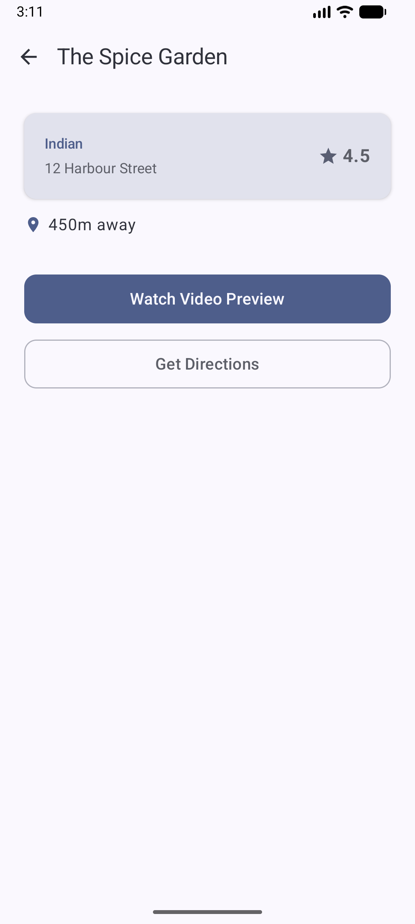
Screen 3 — Restaurant Detail
Full info, video preview, and navigation — the app's key value screen
What This Screen Does
• TopAppBar with back arrow returns user to Map screen
• Restaurant card shows: cuisine type, address, star rating
• Distance row: pin icon + '450m away' (calculated from GPS delta)
•
• Watch Video Preview (filled button):
• Opens a YouTube URL via Android Intent → YouTube app or browser
• URL is stored per restaurant in the seeded data map
• No WebView needed — native YouTube app handles playback
•
• Get Directions (outlined button):
• Builds a maps.google.com URL with the restaurant's lat/lng as destination
• Fires an implicit Intent — Google Maps app opens with turn-by-turn route
•
• Both buttons demonstrated working on the emulator
Notes:
The Restaurant Detail screen is where the two core user actions happen: watch a video to decide if this place looks good, or launch navigation to go there. The Watch Video button uses a simple Android Intent with ACTION_VIEW and a YouTube URL. Android's intent resolution system opens the YouTube app if installed, or falls back to the browser — no custom video player needed, and no YouTube API key required. The Get Directions button constructs a Google Maps URL with the destination lat/lng pre-filled. Again, an implicit Intent opens Google Maps in navigation mode. This pattern — using intents to delegate to installed apps — is efficient, reliable, and avoids re-implementing functionality that system apps already provide.

Slide 10
Progress Summary & What's Next
Phases completed vs. remaining work
DONE Phase 1
Project scaffold, Gradle, API keys
DONE Phase 2
Google Maps + GPS centering
DONE Phase 3
Restaurant markers (seeded data)
DONE Phase 4
Detail screen: video + directions
TODO Phase 5
Live Google Places API integration
TODO Phase 6
Firebase Auth (login / register)
TODO Phase 7
UI polish, loading states, error handling
TODO Phase 8
Bottom nav bar, Home & Utility screens
TODO Phase 9
Final dissertation report writing
Immediate next step: replace seeded restaurant data with live Google Places API Nearby Search calls.
Notes:
To summarise: Phases 1 through 4 are complete and demonstrated on a running emulator. The app has a working login screen, a live Google Map centred on the device GPS, 5 restaurant markers that filter by search, and a detail screen where both Watch Video and Get Directions are functional. The immediate next step is Phase 5 — replacing the 5 hardcoded restaurants with a real Places API Nearby Search call, so the app returns actual restaurants near the user. Phase 6 adds Firebase Authentication to the login screen. Phase 7 and 8 cover UI polish — adding a bottom navigation bar with Home, Map, Privacy, and Contact Us tabs — and proper loading/error states. Phase 9 is the dissertation report, which will document all technical decisions made during development. Overall the project is on schedule and the core technical risk — getting a live Google Map running on a real emulator — has been proven out.

